Slide 1
Machine Learning Hackathon

Slide 2
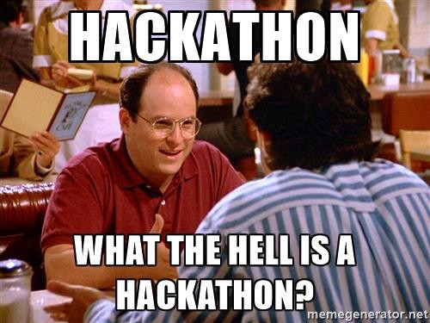
Hack + Marathon = Hackathon
Hack is often defined as an inelegant but effective way to solve a problem

Slide 3

Hackathon Logistics
What is a Hackathon?
2-day online team competition to solve a machine learning problem
Agenda for next 2 days(Timelines)
Day 1– 10 am :: Kick-off and reveal of problem statement and dataset
Day 1 – 10:30 am :: Session - How to approach a hackathon?
Day 1– 4:00 pm onwards :: Team-wise mentoring session
Day 2 – 10:00 am onwards :: Team-wise mentoring session
Day 2 – Midnight :: Deadline to submit presentations

Slide 4
Problem Statement
You are a data scientist at Megakkart the largest ecommerce platform in the country. Owing to the festive season Megakkart is planning a ‘Super Festive Sale’ where it wants to achieve a GMV sales of INR 500 crores. You are being provided with the user data for the past one year on various parameters mentioned below. You need to identify whether the user on the web portal will make a purchase or not. The company plans to work on various hooks for the customers who are at a risk of not making a purchase. Your analysis and machine learning model will help the product team to plan these hooks.

Slide 5
How to submit the solution for evaluation?
The dataset provided has three files
train.csv (labelled data) : training data with 40,000 records | 18 features | 1 target (Revenue)
test.csv (un-labelled data) : test data with 10,000 records | 18 features
sample_submission.csv (submission format) : – sample file to be used as template for submission of predictions
Teams need to submit the csv file along with predicted labels in the sample_submission.csv format.
You can see/download Problem statement, data dictionary, datasets, leaderboard https://mlhackathon-app2.herokuapp.com/ (max of 15 submissions)
The final Jupyter Notebook file(.ipynb and .html) along with any intermediate processed datasets & PPT/ Video (optional) in zip format can be submitted on the below link https://forms.gle/Kb6Awm9DrVeSK1cg7
Notes:
sample_submission.csv (submission format) : – sample file to be used as template for submission of predictions
Based on test data

Slide 6
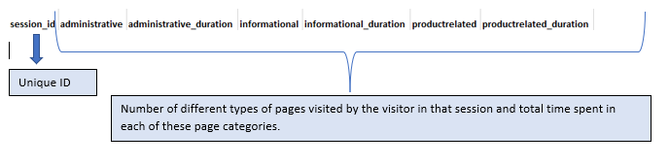
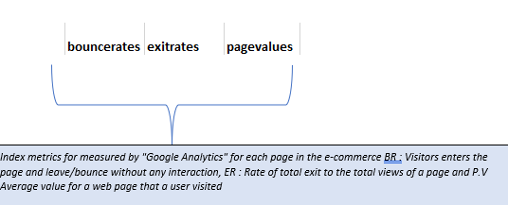
Data Description
Target variable

Slide 7

Evaluation #Leader board is not the only criteria of final evaluation
Each team will have submit their solutions in a PPT / PPT Video format.
The teams will be evaluated on following
Exploratory data analysis and insights from the data (10 points)
Accuracy of the model –Leaderboard score (10 points)
Presentation Skills (5 points)
At the end of the hackathon all teams need to submit
The final Jupyter Notebook file along with any intermediate processed datasets
Presentation Files & Video (if any)

Slide 8

Prizes
Winning Team
Amazon Gift Voucher worth INR 1,000/- for each team member
1st Runner Up
Amazon Gift Voucher worth INR 500/- for each team member
Digital Certificate of participation to all
Best presentation will be uploaded to the Times TSW YouTube channel along with mention on a social media post.

Slide 9
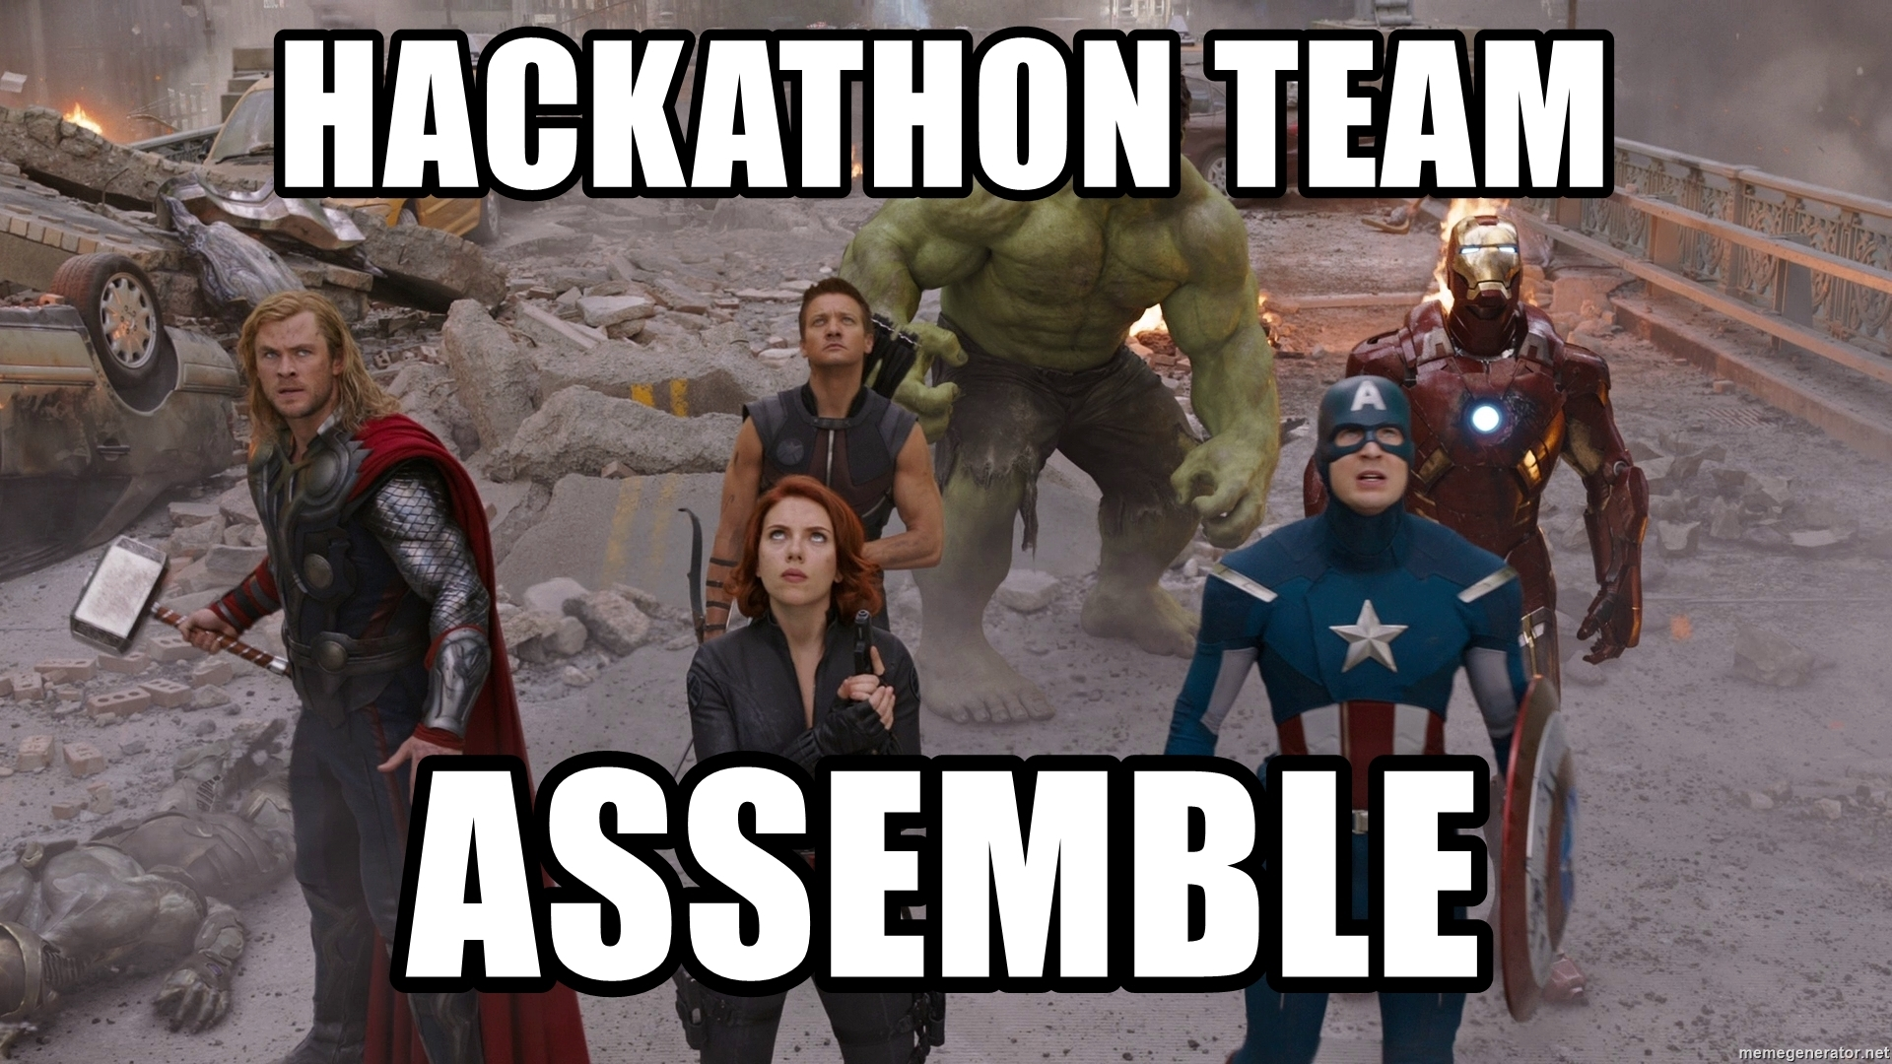
Teams
Teams can interact within themselves use
Google Meet
Individual Zoom accounts
Airmeet
Use Google Colab for seamless collaboration

Slide 10
Questions?

Slide 11
How to approach a Hackathon?

Slide 12
Steps to be followed
Understand the dataset
Total number of features available
Target feature and its distribution
Data types of different features (number, text, Boolean, date, etc.)
Types of features (numerical and categorical)
Missing values
Number of unique values in categorical features

Slide 13
Steps to be followed
Clean / pre-process data
Remove or impute missing values
Check for outliers and take corrective action
Check for any incorrect values
Encode categorical / scale numerical features

Slide 14
Steps to be followed
Explore the data
Hypothesis generation Ex: Are self employed customers more prone to credit default?
Univariate analysis to check the distribution of each feature
Histogram
Pie Chart
Bar Chart
Bivariate analysis to check the hypothesis and get insights
Multiple bar chart
Line chart
Correlation and Multi-collinearity

Slide 15
Steps to be followed
Explore the data
Univariate analysis to check the distribution of each feature
Histogram
Pie Chart
Bar Chart
Bivariate analysis to check the hypothesis and get insights
Multiple bar chart
Line chart
Correlation and Multi-collinearity

Slide 16
Steps to be followed
Feature Engineering
Derive additional features from one feature
Ex: From date you can extract features like month, weekday, day of the month, year, etc.
Derive additional features from two or more features
Ex: Total price can be calculated based on quantity and per unit price

Slide 17
Steps to be followed
Apply machine learning model
Train the machine learning model on the train data and apply cross validation on the performance metric(Accuracy)
Tune the parameters to improve the validation scores(Accuracy)
Check the feature importance and retrain the model with important/significant feature. You may take input from EDA as well
After you are satisfied with the model's performance, make predictions on the provided “test set”
Create a csv file in the provided format and submit the same.

Slide 18
Steps to be followed
Apply machine learning model
Train the machine learning model on the train data and apply cross validation
Check the feature importance and retrain the model with important/significant feature. You may take input from EDA as well
After you are satisfied with the model's performance, make predictions on the provided “test set”
Create a csv file in the provided format and submit the same.

Slide 19
Suggestions
Spend more time in
understanding the data,
obtaining visuals and inferences and
rest on model building
Final presentation should be more business focused than keeping it too technical – Technical details to be added in the appendix

Slide 20


Slide 21
Questions?

